Slide 1
British Airways
Customer Reviews Analysis and Insights

Slide 2
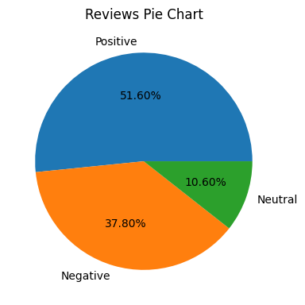
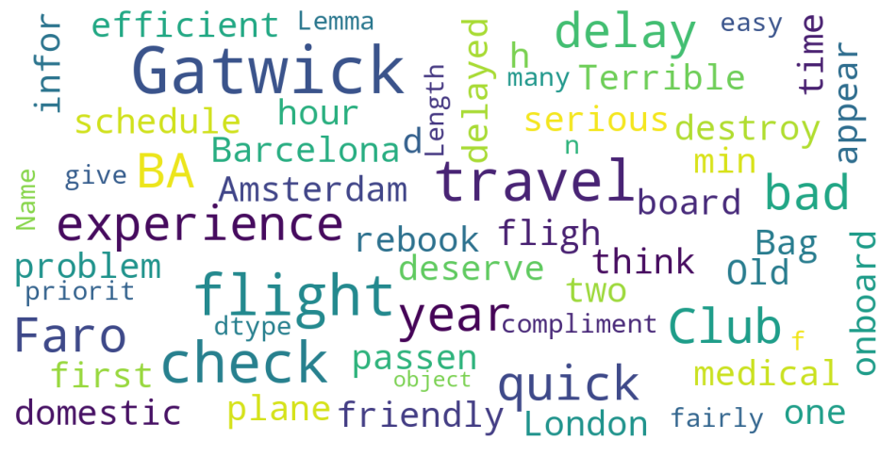
Here is Pie Chart and WordCloud Of Reviews given by BA Customers.
The 3 categories of reviews that we got were, Positive, Negative and Neutral.
We analyze on 1000 reviews and the insights were:
Positive Reviews: 516 Negative Reviews: 378 Neutral Reviews: 106

